Slide 1
Marquee Console
Daniel Gavrie Y. Clemente

Slide 2
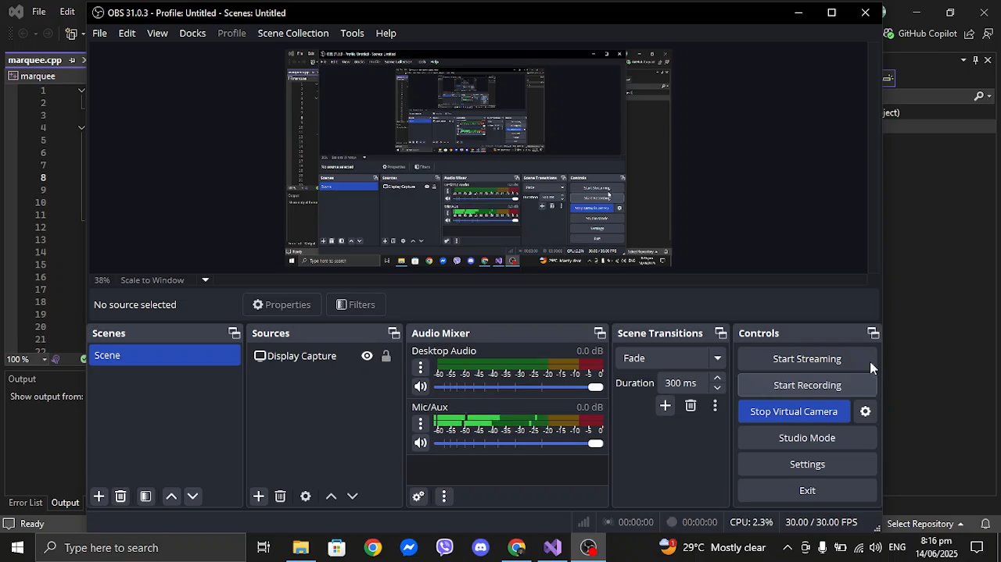
Marquee Console w/Multithreading

Slide 3
Marquee Console w/Multithreading
C++ console application
Simulates a moving message
Accepts user commands (exit, clear)
Demonstrates concurrency with animation + input handling

Slide 4
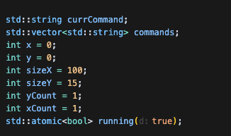
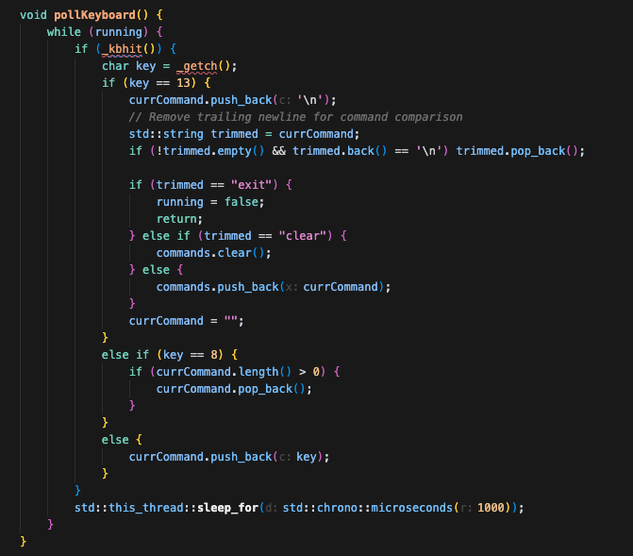
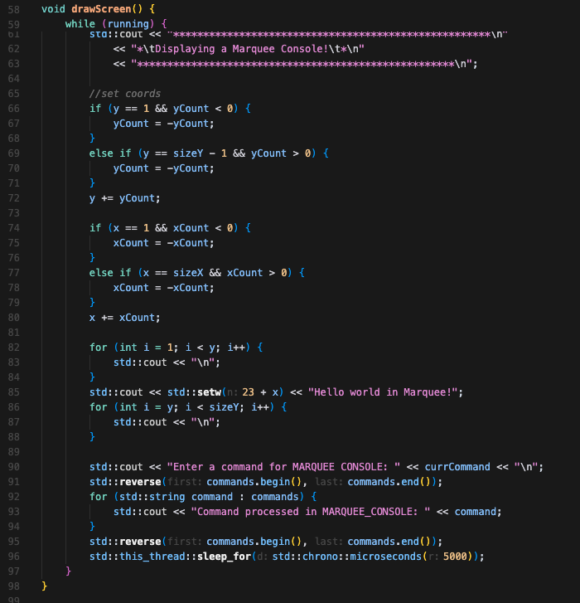
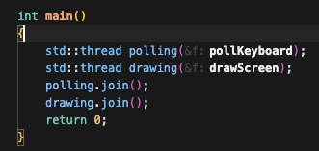
Marquee Console w/Multithreading
pollKeyboard(): Handles real-time keypresses
drawScreen(): Renders marquee text and UI
main(): Starts and joins both threads
Avoids input lag using std::atomic<bool> running for safe thread stop

Slide 5
Refresh vs Polling Rate
Smoothness of animation = refresh
Responsiveness to typing = polling rate
Component | Interval
pollKeyboard | 1000 microseconds (1 ms)
drawScreen | 5000 microseconds (5 ms)

Slide 6
Performance Tuning on My Machine
Recommended:
Polling Rate: 1 ms
Refresh Rate: 5 ms
Parameter | Observed Result
Refresh ≤ 5ms | Smooth motion, no flickering
Polling ≤ 1ms | Fast typing, near-instant command input
Refresh > 15ms | Noticeable lag, jittery motion
Polling > 15ms | Delay in keypresses

Slide 7
Identifying Limits
Too Fast Refresh (e.g. < 2 ms):
High CPU usage
Terminal can't keep up → screen tearing
Too Slow Polling (e.g. > 20 ms):
Input delay
Missed fast keystrokes

Slide 8
Conclusion
Careful tuning of polling and refresh rates is essential.
Balancing smooth UI with responsive input is key.
Current best setting (on tested machine):
Polling: 1 ms
Refresh: 5 ms

Slide 9
End of slides

